Slide 1
Steering Wheel Mechanism
By: Hitarth, Aarav and Alex.

Slide 2
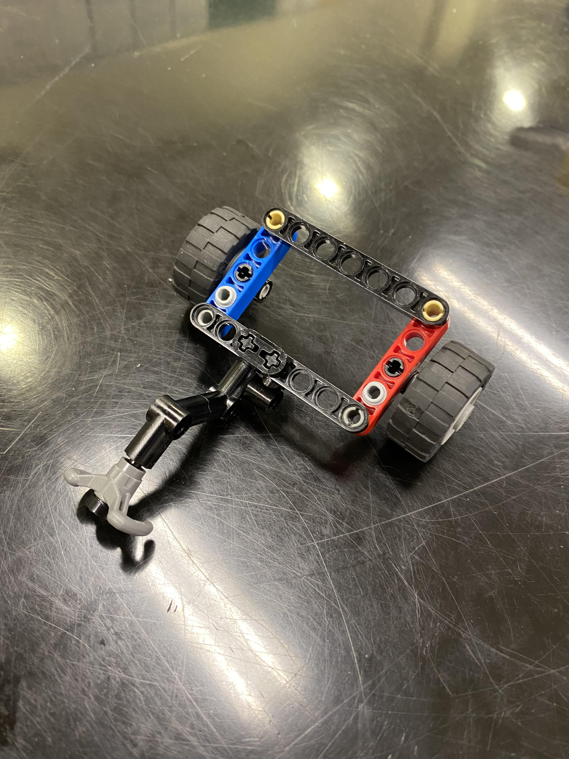
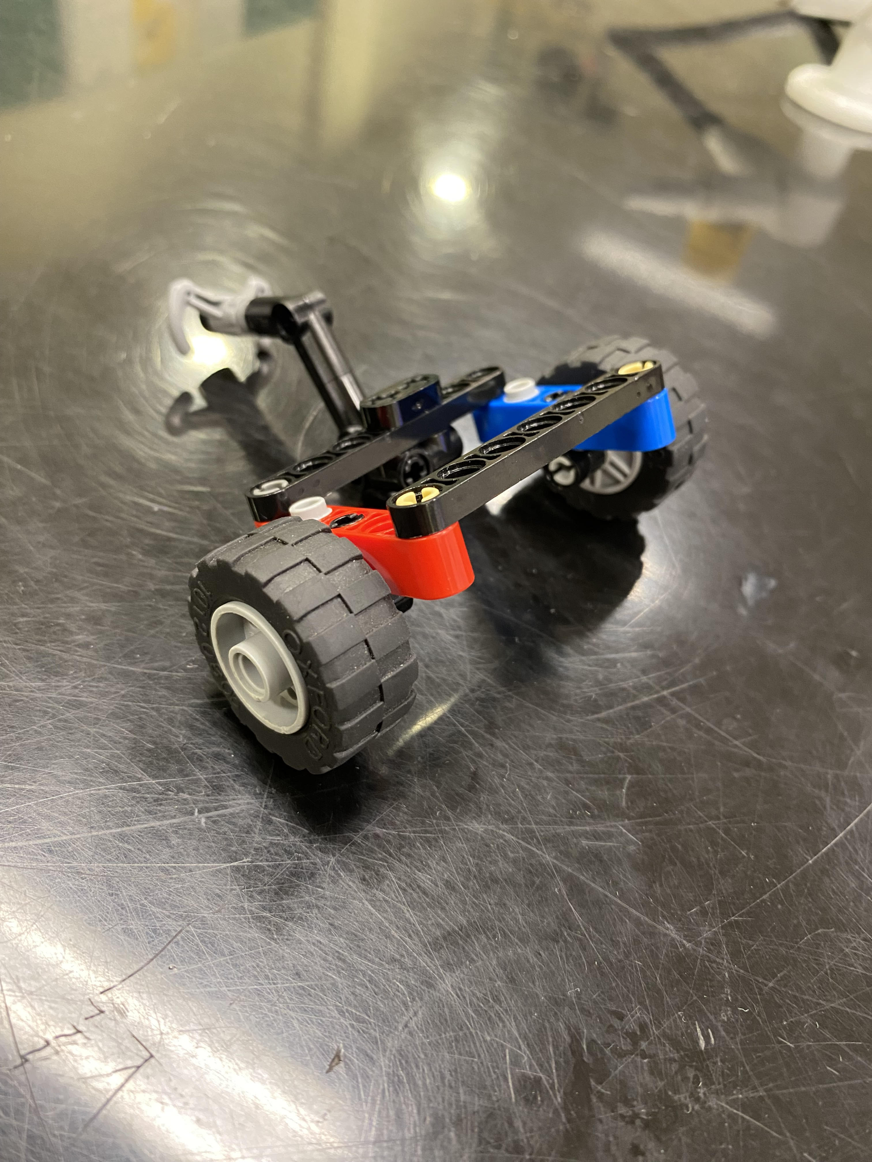
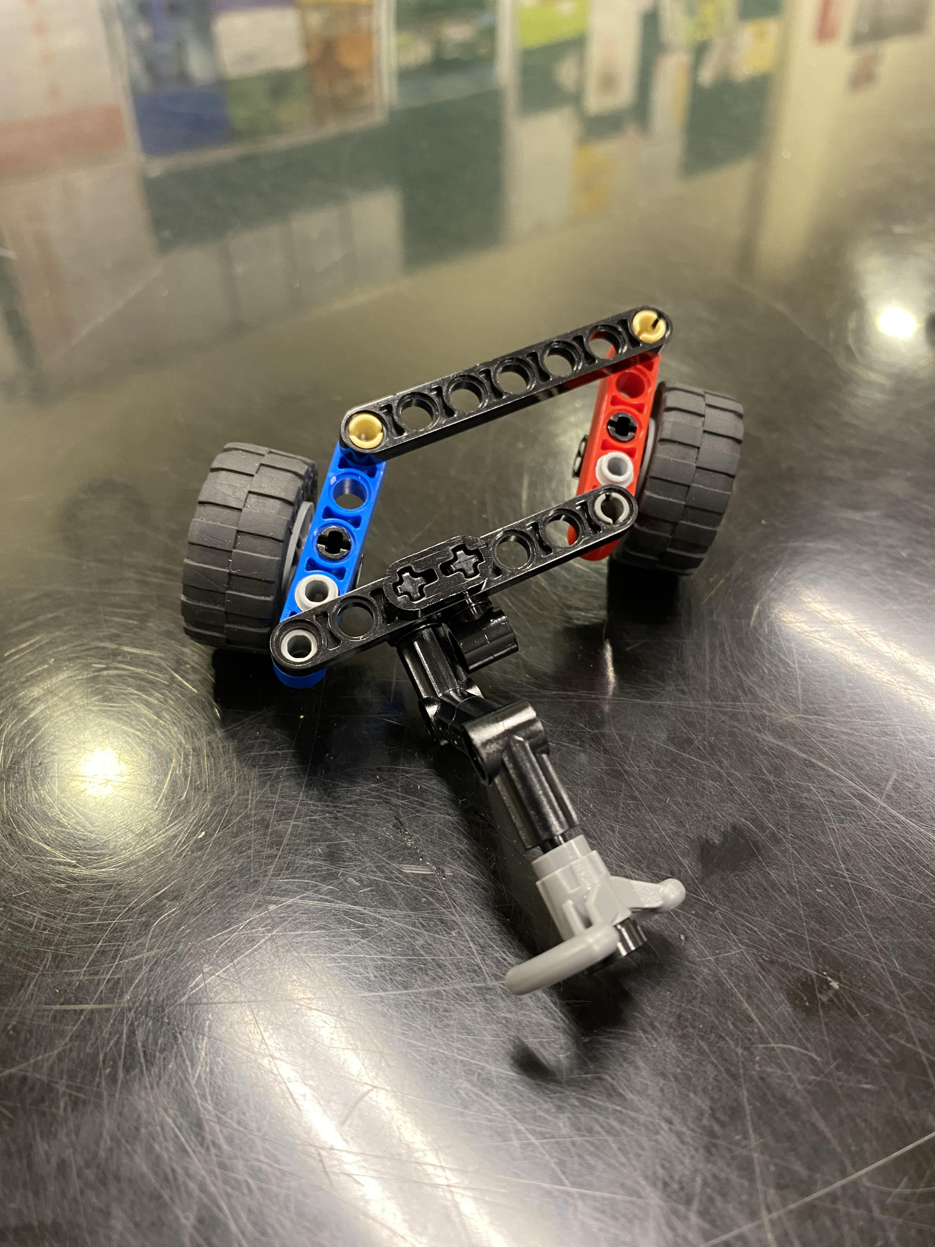
Our Model
Limited because we used lego

Slide 3
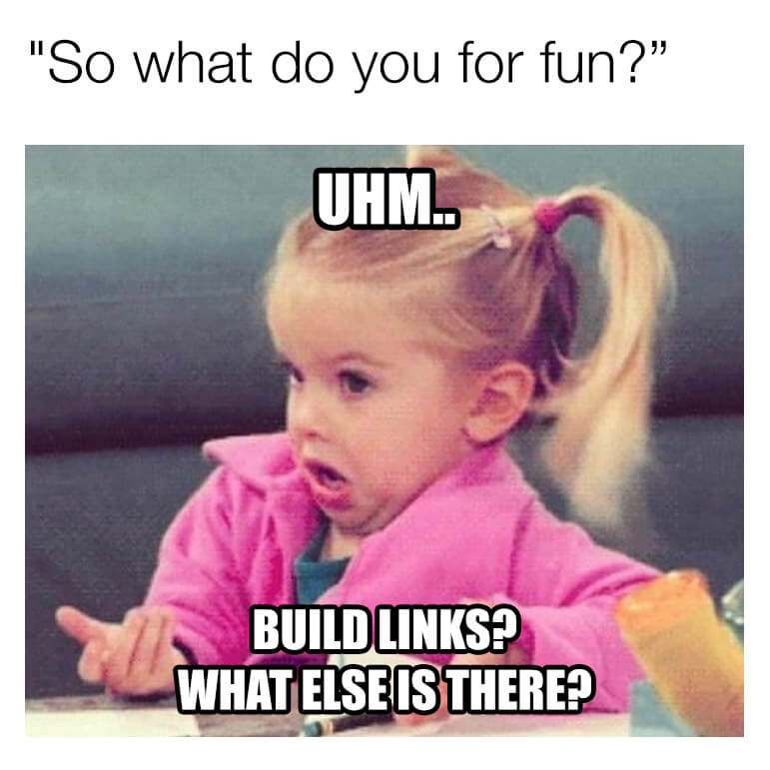
How it (‘s supposed to) works:
Steering wheel is connected to the universal joint
The joint connects to a rack and pinion system.
As the rack moves back and forth, it moves a parallelogram linkage that turns the wheels.

Slide 4
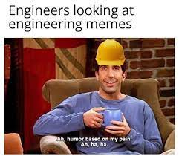
What we could improve on
The steering wheel could move the wheel mechanism
We find a way to make the turning angles more stable so that it is easier to turn.
Add a separate technic frame so it stays firm on the ground

